Slide 1
Cosmic Inflation
Superviser:
Prof. Koushik Dutta
Raj Gaurav Tripathi
(22MS215)

Slide 2
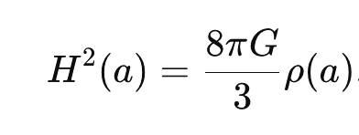
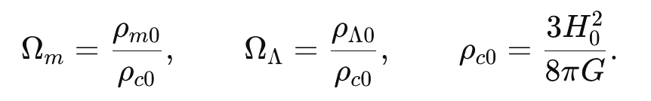
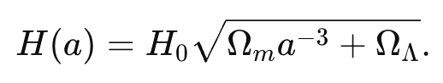
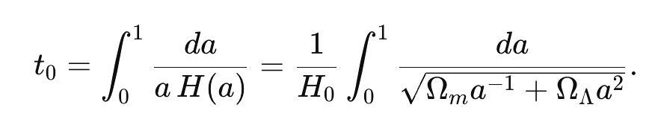
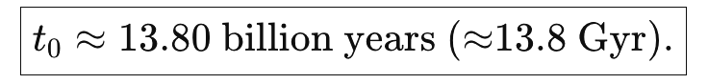
Age of Universe

Slide 3

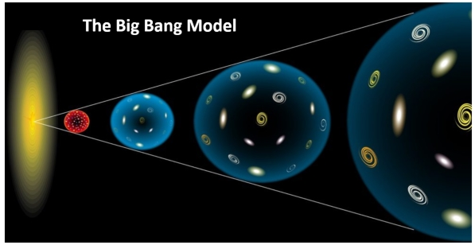
The Standard Big Bang
Theory that the universe as we know it began 13.82 ± 0.05 billion years!
Initial state was a hot, dense, uniform soup of particles that filled space uniformly, and was expanding rapidly.
What it Describes:
How the early universe expanded and cooled.
How the light chemical elements formed.
How the matter congealed to form stars,
galaxies, and clusters of galaxies..

Slide 4
DOES BIG BANG EXPLAIN EVERYTHING?

Slide 5
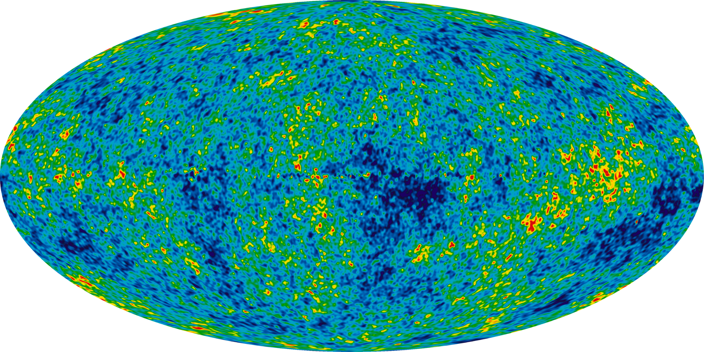
Cosmic Microwave Background Radiation
CMB was released during decoupling
Variations of only about 1 part in 100,000
It feels good that our universe is flat..
Faint background.
Isn’t it?
NO!

Slide 6
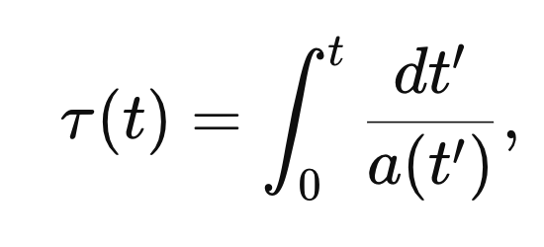
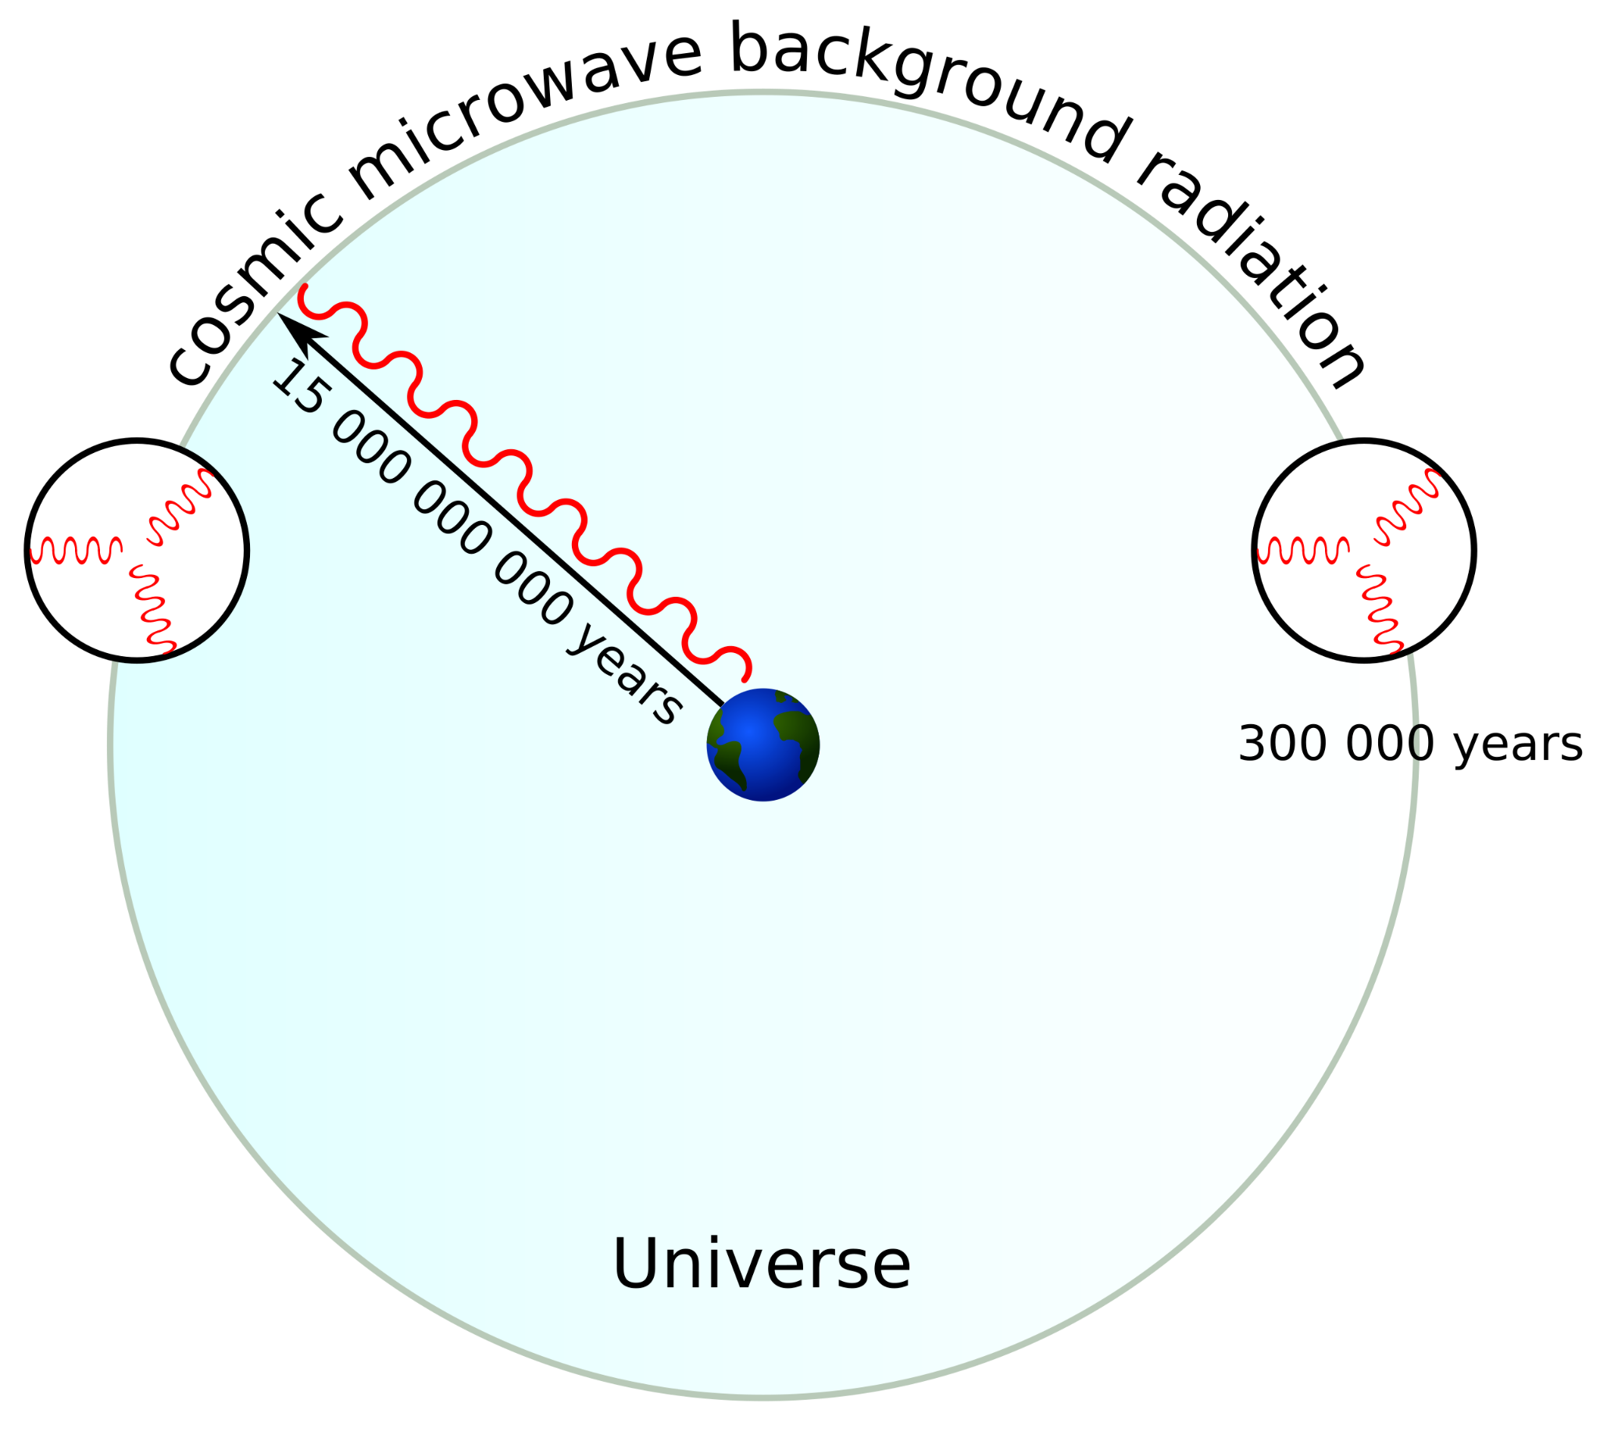
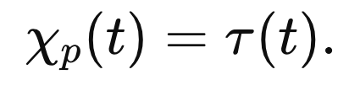
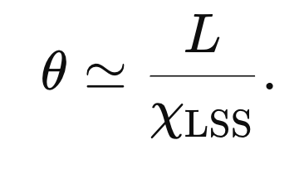
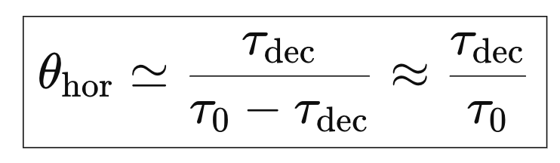
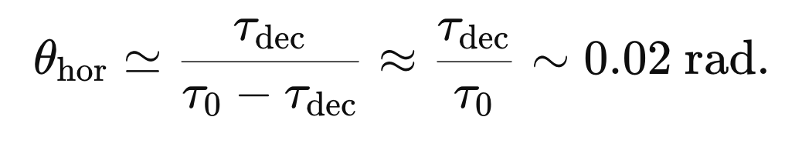

Slide 7
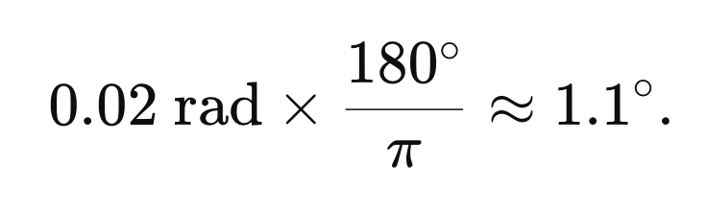
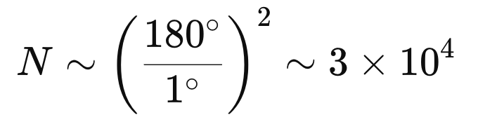
Problem 1: Horizon Problem

Slide 8
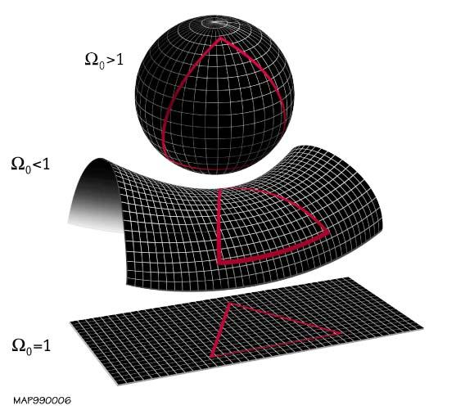
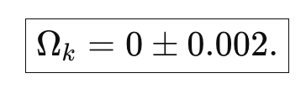
Flat Universe
Plank:
It feels good that our universe is flat..
Isn’t it?
NO!

Slide 9
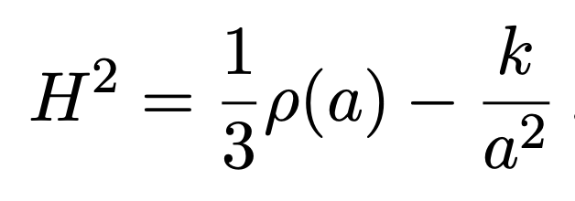
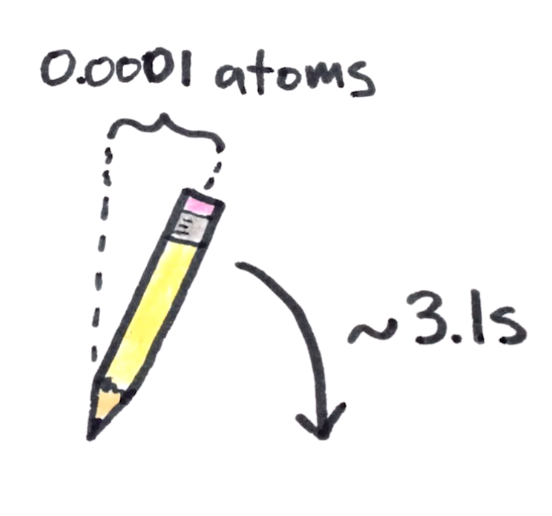
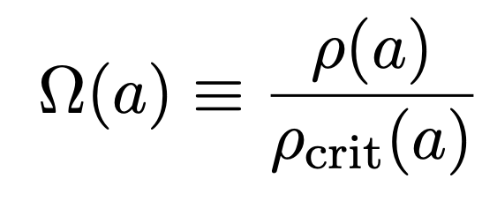
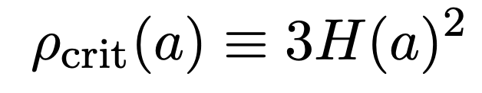
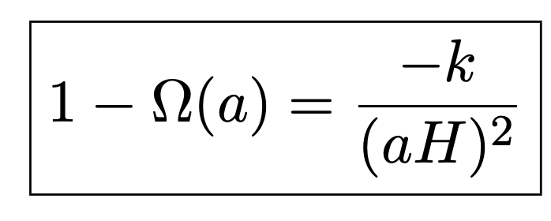

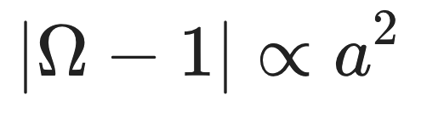
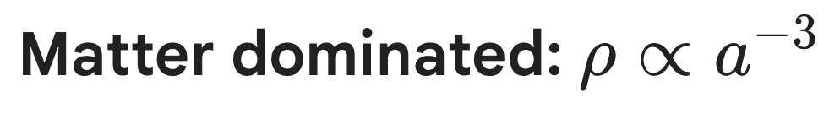
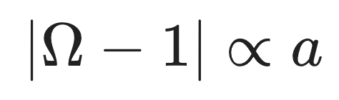
Problem 2: Flatness Problem

Slide 10
What is Needed?
A Period of Accelerated Expansion!

Slide 11
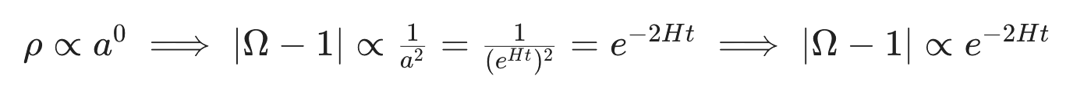
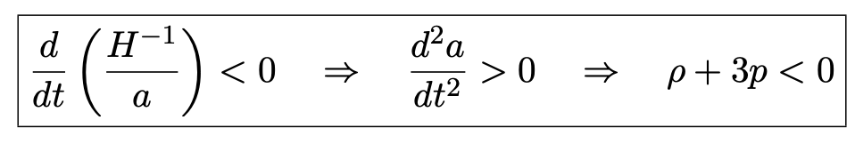
INFLATION
A period of accelerated expansion.
Miracle of Physics #1: Gravity can be repulsive!
Miracle of Physics #2: Energy of Gravitational field is negative!

Slide 12
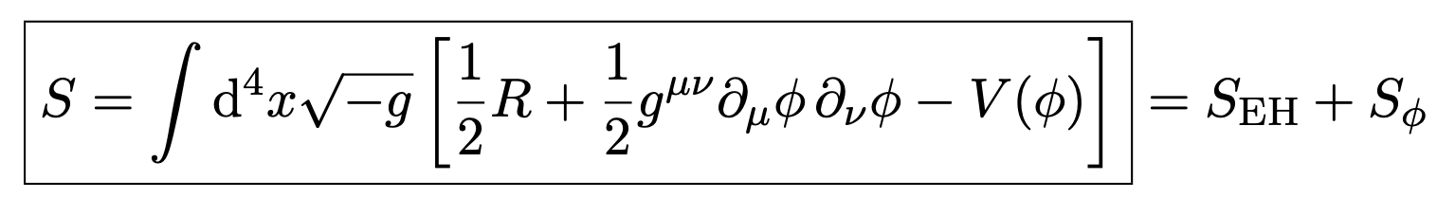
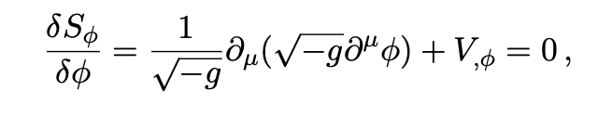
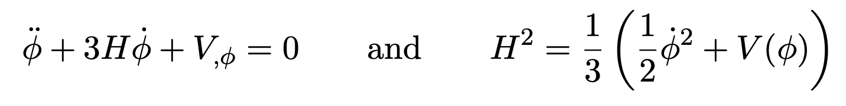
Scalar Field Dynamics of Inflation
The dynamics of a scalar field (minimally) coupled to gravity is governed by the action
Friedmann-Klein-Gordon equation for homogeneous scalar field in an expanding universe.

Slide 13
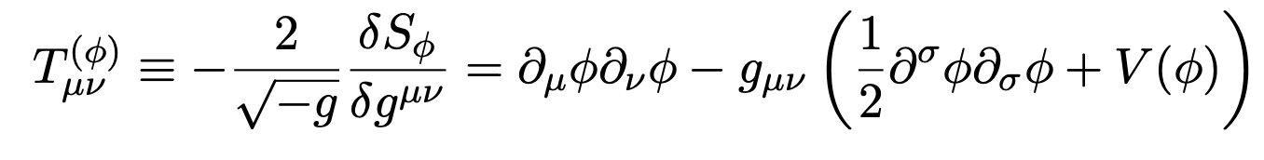
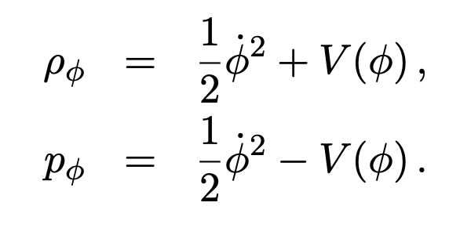
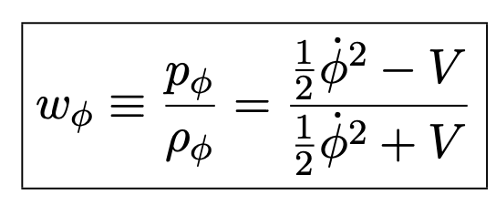

The energy-momentum tensor for the scalar field.

Slide 14
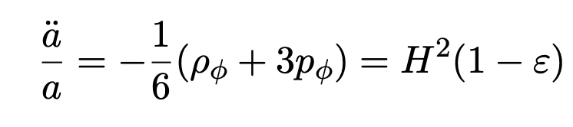
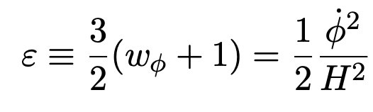
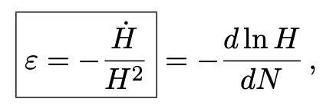
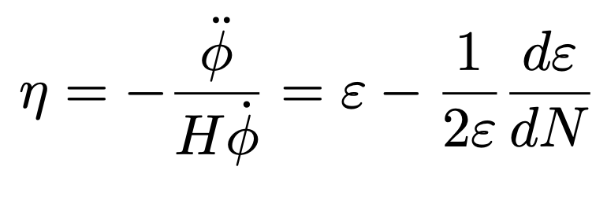

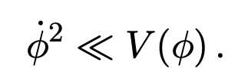
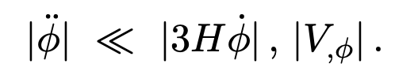
Slow Roll Inflation

Slide 15
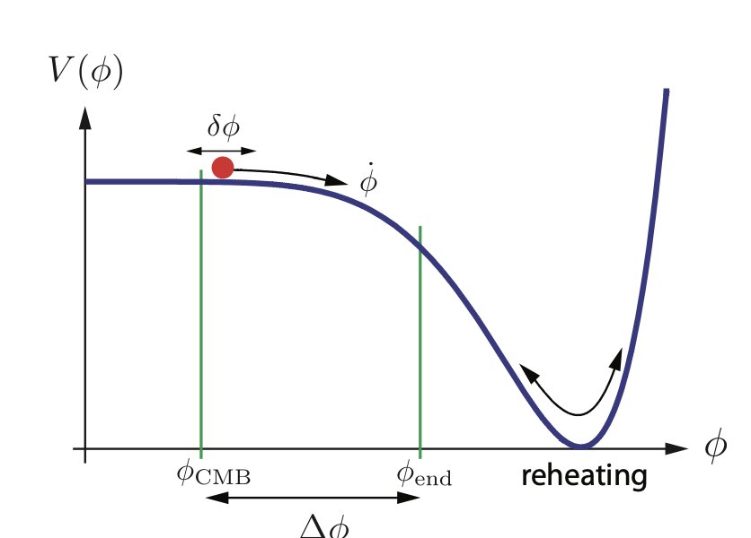
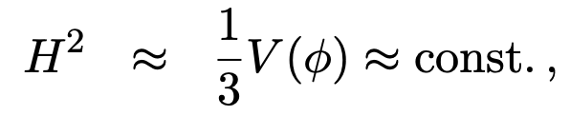
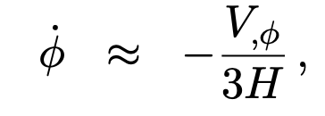
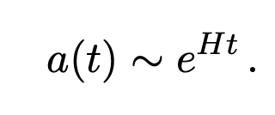

Slide 16
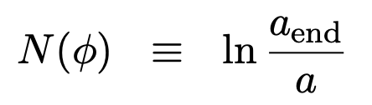
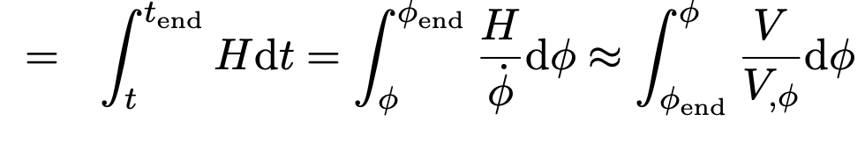
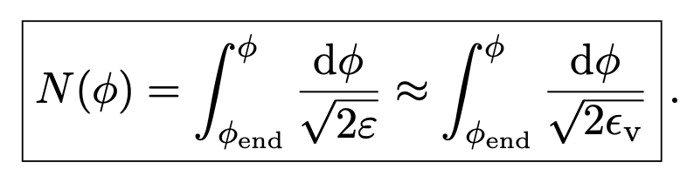
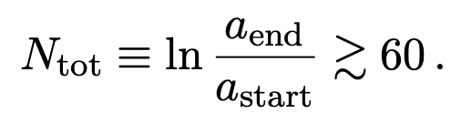

How Much expansion we need?
Eventually, the inflationary energy density is converted into standard model degrees of freedom and the hot Big Bang commences.

Slide 17
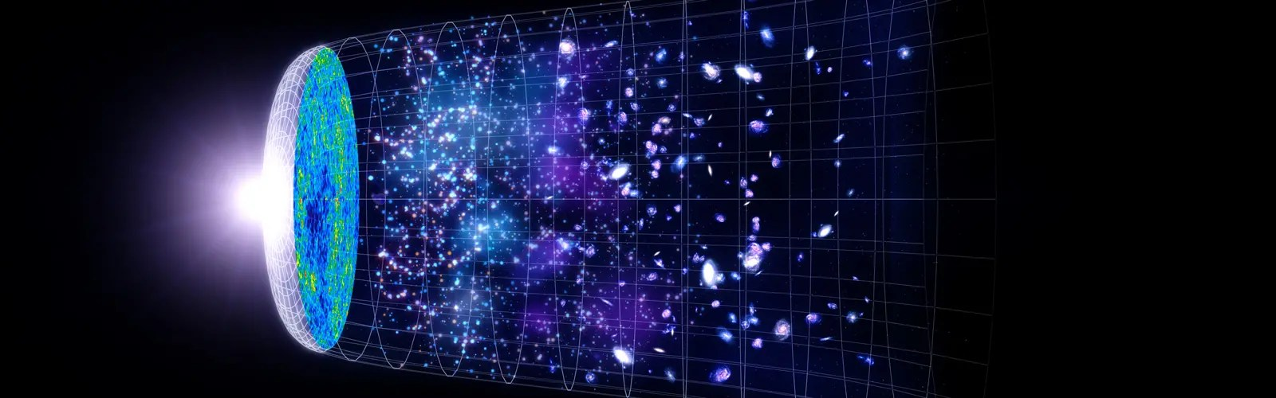
THANK YOU

